Slide 1



INTRODUCING
THE FRAGRANCE AMPLIFIER
AN INNOVATION BY
PRESENTED TO

Slide 2





OVERVIEW
WHAT IS HALOSCENT?
HaloScent® is an innovative fragrance technology that enhances the longevity and intensity of scents in various products.
LAUNDRY CARE
FINE FRAGRANCES
HAIR CARE

Slide 3
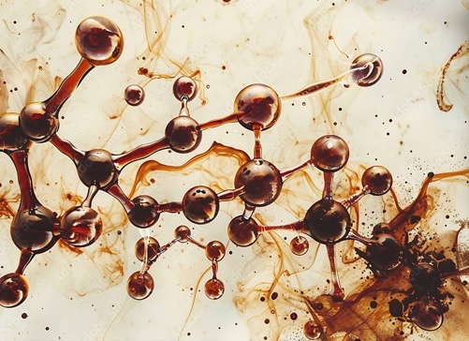



TECH-
HOW DOES HALOSCENT WORK?
THE FACTS
HaloScent® Profragrance systems consist of two bonded fragrance molecules. One adheres to surfaces for long-lasting scent, while the other evaporates quickly for immediate fragrance release.
THE REACTION
NOLOGY
When exposed to natural triggers like oxygen, heat, or enzymes, the bond breaks, and the volatile perfume molecule gradually releases over time.

Slide 4



INNOVATIVE BIODEGRADABLE PROFRAGRANCES
Our new generation of biodegradable profragrances delivers a new experience by releasing not only one but two perfume molecules over time.
This unique innovation creates a halo effect, enabling the entire fragrance to last longer for a more rounded olfactive experience.

Slide 5


Slide 6



VISUALIZE
HALOSCENT VISUAL DEMONSTRATION
1
2
3
MOLECULES BOUND TOGETHER
NATURAL TRIGGER ACTIVATION
GRADUAL FRAGRANCE RELEASE
Two fragrance molecules are bonded together, creating a profragrance system.
Natural triggers like oxygen, heat, or enzymes break the bond.
The volatile perfume molecule gradually releases over time, creating a long-lasting halo effect.

Slide 7










THE
COLLECTION
MINT CRISP
BERRY BOOST
DREAM FRESH
EVER FLORAL
VIOLET

Slide 8


BENEFITS
WHAT MAKES HALOSCENT AMAZING
AMPLIFIED FRAGRANCE
Enhanced and longer-lasting exquisite scents.
BIODEGRADABLE
Environmentally friendly technology.
VERSATILE
Suitable for various product categories.

Slide 9


CONCLUSION
HALOSCENT IN SUM
HaloScent ® is a patented technology that gradually releases fragrance molecules over time, enhancing and prolonging the scent experience.
THANK YOU FOR YOUR TIME & ATTENTION!
We open the floor to questions…

